Slide 1
URL Shortener

Slide 2
Assertions For Demo Application
Application will be completely available, hence runtime cache is being used.
All users are valid and not involved in malicious activities.
Application is read heavy

Slide 3
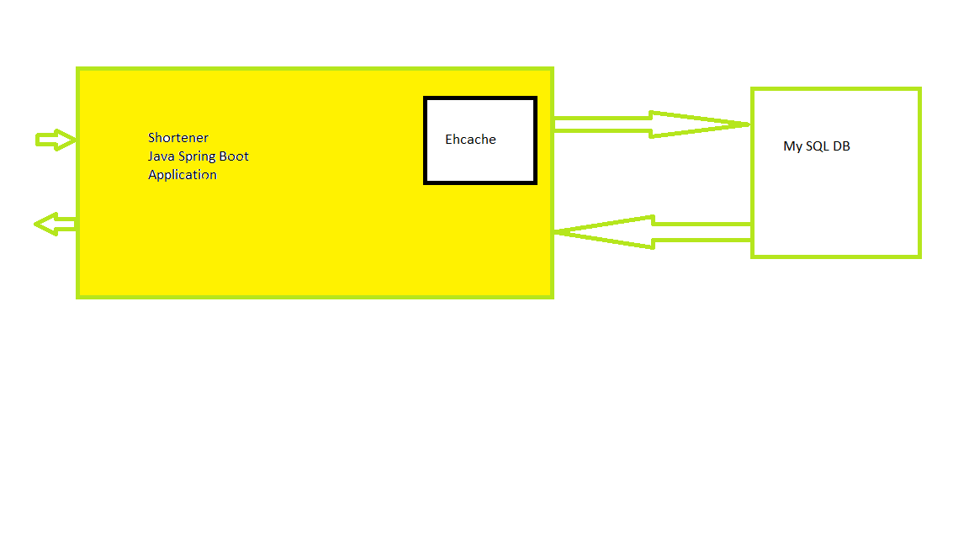
Technical Architecture

Slide 4
Demo

Slide 5
Future Improvements
Key Generation Service
Common Cache for multiple instances
User Profile and authentication

Slide 6
Questions?

